Slide 1
Statistics: Basic Concepts

Slide 2
Individuals and Variables
Individual: Item in a data set
Variable: Property of an individual
Independent variable (Feature): Used to predict something
Dependent variable: The predicted value
Person | Hours of Study | Grade
Alice | 100 | B
Bob | 130 | A
Charlie | 60 | E
Dave | 90 | C
Person: Individual
Variable: Hours of Study, Grade
Independent variable/Feature: Hours of Study
Dependent variable: Grade

Slide 3
Variable Types: Qualitative and Quantitative
Qualitative variables: Categorical (e.g. Grade), Non-numeric
Quantitative variables: Numeric, Can be measured (e.g. Hours of Study)
Person | Hours of Study | Grade
Alice | 100 | B
Bob | 130 | A
Charlie | 60 | E
Dave | 90 | C

Slide 4
Variable Classification
Variables/Data
Quantitative/Numeric
Qualitative/Categorical
Discrete
Continuous
Nominal
Ordinal
Interval
Ratio

Slide 5
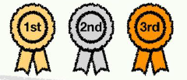
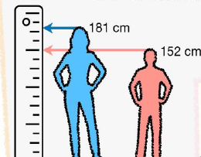
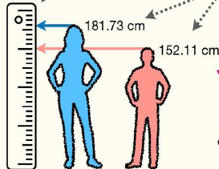
Quantitative Variable Sub-types
Discrete variables: Countable and take specific values … Example: Rank: 1, 2, 3 but not 1.8
Continuous variables: Measurable, but not a specific value … Example: Height of a person: 5 feet 5 inches 5 cm 2 mm …..

Slide 6
Levels/Scales of Measurement of Data
Level | Details | Examples
Nominal | Categorical data with no inherent order or ranking | Gender, Colour, Cuisine
Ordinal | Categorical data with a meaningful order or ranking, but intervals between ranks are inconsistent or unknown | Education level (High school, Bachelor’s, Master’s), Customer satisfaction (Satisfied, Neutral, Unsatisfied)
Interval | Numeric data with meaningful and consistent intervals between them without a true zero point … Ratio cannot be measured | IQ, Calendar data, Time of the day, Temperatures in Celsius or Fahrenheit
Ratio | Numeric data where both intervals and ratios are meaningful and there is a true zero point | Height, Weight, Income, Distance travelled, Student marks
True zero point: Does the value of 0 actually indicate the start?
Ratio data: Height of 0 inches means 0 inches, or income of 0 means $0, etc … Nothing can be lower than this ... (0 is NOT arbitrary)
Interval data: Temperature of 0 degrees Celsius does not mean the lowest temperature, as we can have -1 degrees Celsius, etc … (0 is arbitrary)
Ratios
Is a person with IQ 150 three times more intelligent than a person with IQ 50? No!
Has a student who has got 90 marks done three times better than a student who has got 30 marks? Yes!

Slide 7
Descriptive Statistics

Slide 8
Measures of Location
Measures of Location: A single value that represents the “centering” of a set of data, e.g. average
Also called Measures of Central Tendency
Example: Marks obtained by 10 students, arranged in an ascending order … 45,56,61,65,68,71,73,79,82,88,91
Possible measure of location:
45,56,61,65,68, 71, 73,79,82,88,91
Measures of Location
Mean
Mode
Median

Slide 9
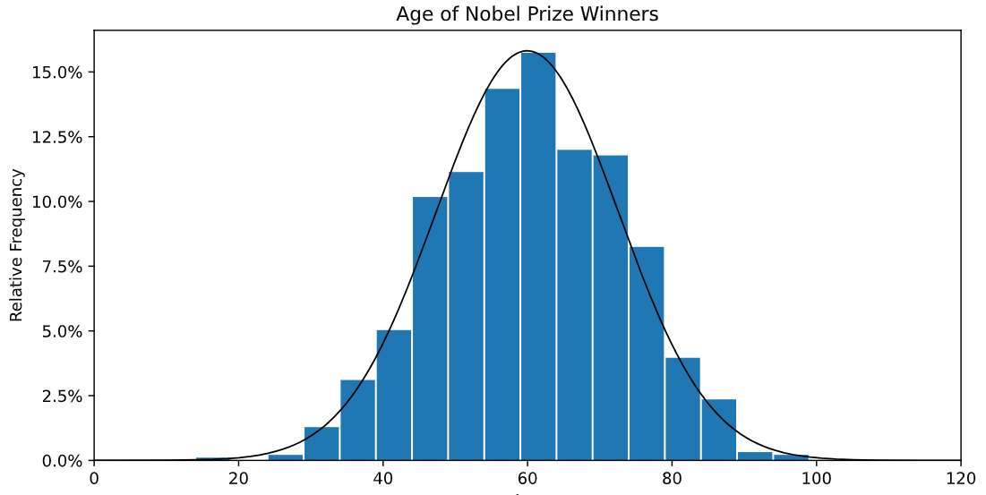
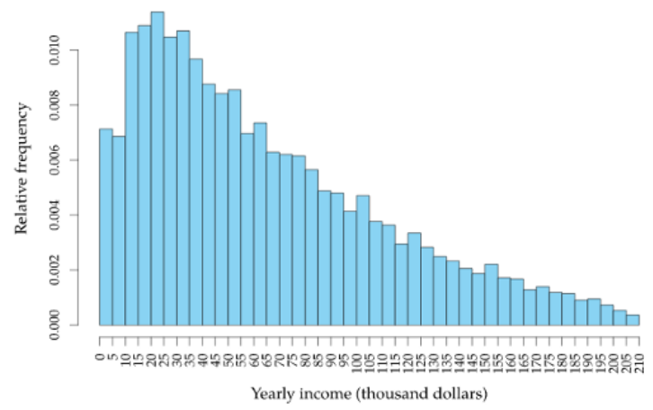
Basic Usage
Mean: Better if the data is normally distributed and there are no outliers … Used for interval and ratio data
Median: Better when the data is skewed (has extreme values) … Used for ordinal, interval, and ratio data
Mode: Useful for identifying the most common value or values in a dataset … Used in all the four scales … Best for categorical data
Normally distributed data
Skewed data

Slide 10
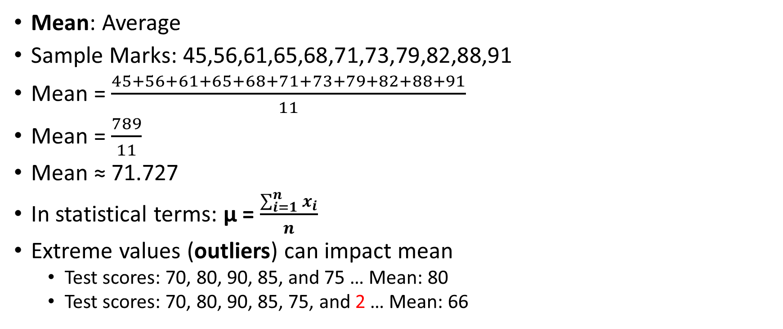
Mean
Mean: Average
Sample Marks: 45,56,61,65,68,71,73,79,82,88,91
Mean = $\frac{45+56+61+65+68+71+73+79+82+88+91}{11}$
Mean = $\frac{789}{11}$
Mean ≈ 71.727
In statistical terms: μ = $\frac{\sum_{i=1}^{n}{x_{i}}}{n}$
Extreme values (outliers) can impact mean
Test scores: 70, 80, 90, 85, and 75 … Mean: 80
Test scores: 70, 80, 90, 85, 75, and 2 … Mean: 66

Slide 11
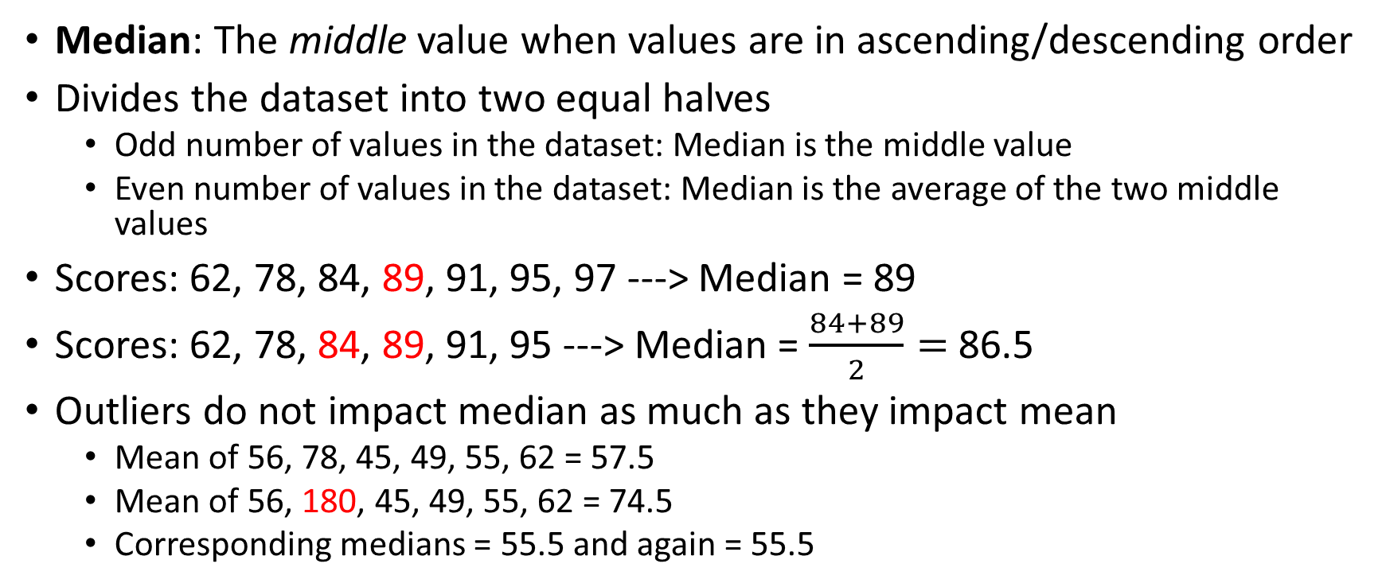
Median
Median: The middle value when values are in ascending/descending order
Divides the dataset into two equal halves
Odd number of values in the dataset: Median is the middle value
Even number of values in the dataset: Median is the average of the two middle values
Scores: 62, 78, 84, 89, 91, 95, 97 ---> Median = 89
Scores: 62, 78, 84, 89, 91, 95 ---> Median = $\frac{84+89}{2}=$86.5
Outliers do not impact median as much as they impact mean
Mean of 56, 78, 45, 49, 55, 62 = 57.5
Mean of 56, 180, 45, 49, 55, 62 = 74.5
Corresponding medians = 55.5 and again = 55.5

Slide 12
Mode
Mode: The value that occurs most frequently in a dataset
Data: 62, 78, 84, 89, 91, 95, 97, 89, 91, 89
Frequency: 62: 1, 78: 1, 84: 1, 89: 3, 91: 2, 95: 1, 97: 1
Mode = 89
What if there are multiple values with the same highest frequency?: Multimodal data
If we have two modes: bi-modal
If we have three modes: tri-modal
Not used much in practice

Slide 13
Feature Engineering
Feature engineering: Transform raw data into meaningful features
Why? Improve the performance of the machine learning models
How?
Create new columns (From Date of purchase, create weekday/weekend)
Scale features (Bring features on the same scale, e.g. age and income)
Encode categorical features (Gender: Convert F = 0, M = 1), since ML models work with numeric data
Handle missing data (Drop, Indicate using a Missing flag, or Impute with mean/mode/median)
Feature selection (Keep only the most relevant features)
Feature interaction (From unit price and quantity, create bill amount)

Slide 14
Feature Engineering Example
Consider some sample data
How to handle missing data?
Plot all age values on a graph and see if you see symmetry
If yes, impute missing values with mean, else with median: Repeat for others
Age | Weight | Salary (K) | Gender | Degree
24 | 70 | 40 | M | BE
25 | 65 | 50 | F | BTech
27 | 85 | 65 | F | -
- | 72 | 45 | - | BE
25 | - | 55 | F | BTech

Slide 15
Measures of Dispersion
Spread: How and by how much, our data set is spread out around its center?
Called Measures of Dispersion or Scatter
Measures of Dispersion
Range
Variance
Standard Deviation

Slide 16
Range
Range: Difference between the maximum value and the minimum value in the data set
Affected by outliers
Example: 8, 11, 5, 9, 7, 6, 2500
Range = Max – Min = 2500 – 5 = 2495, which is quite meaningless
Solution: Inter Quartile Range (IQR)
But first, we need to understand percentile and quartile
Range
Minimum
Maximum

Slide 17
Percentile
Percentile (Relative): ≠ Percentage (Absolute)
Percentile: A value below which certain percentage of observations lie
Slices percentage data into two parts: Below a certain cut off, Above the same cut off
k^{th} percentile = k% data is below it, and rest is above it
Examples:
If you are in the 90th percentile in an examination, 90% students are below you and 10% students are above you
If a patient’s blood pressure is in the 60th percentile, 60% patients have a blood pressure less than this patient, and 40% patients have higher blood pressure than this patient
Median = 50th percentile

Slide 18
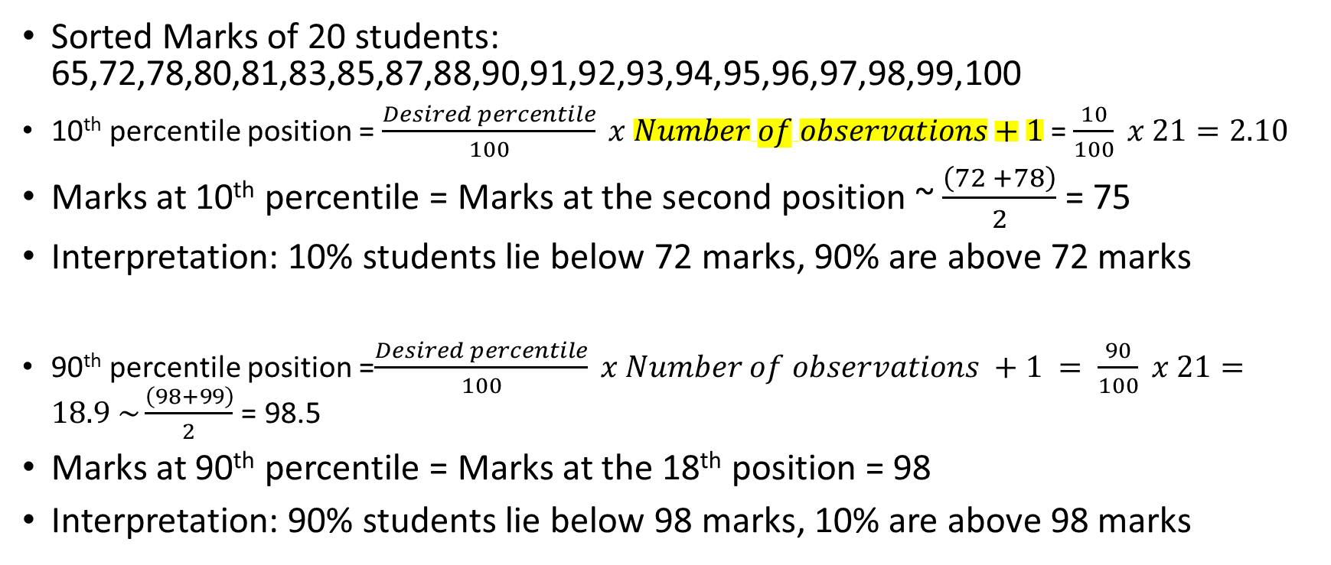
Percentile Example
In some references, we might see Number of observations, rather than Number of observations + 1 … Generally does not make a big difference
Sorted Marks of 20 students: 65,72,78,80,81,83,85,87,88,90,91,92,93,94,95,96,97,98,99,100
10th percentile position = $\frac{Desired percentile}{100} x Number of observations+1$= $\frac{10}{100} x 21=2.10$
Marks at 10th percentile = Marks at the second position ~ $\frac{\left(72 +78\right)}{2}$= 75
Interpretation: 10% students lie below 72 marks, 90% are above 72 marks
90th percentile position =$\frac{Desired percentile}{100} x Number of observations +1 = \frac{90}{100} x 21=18.9 \sim \frac{\left(98+99\right)}{2}$ = 98.5
Marks at 90th percentile = Marks at the 18th position = 98
Interpretation: 90% students lie below 98 marks, 10% are above 98 marks

Slide 19
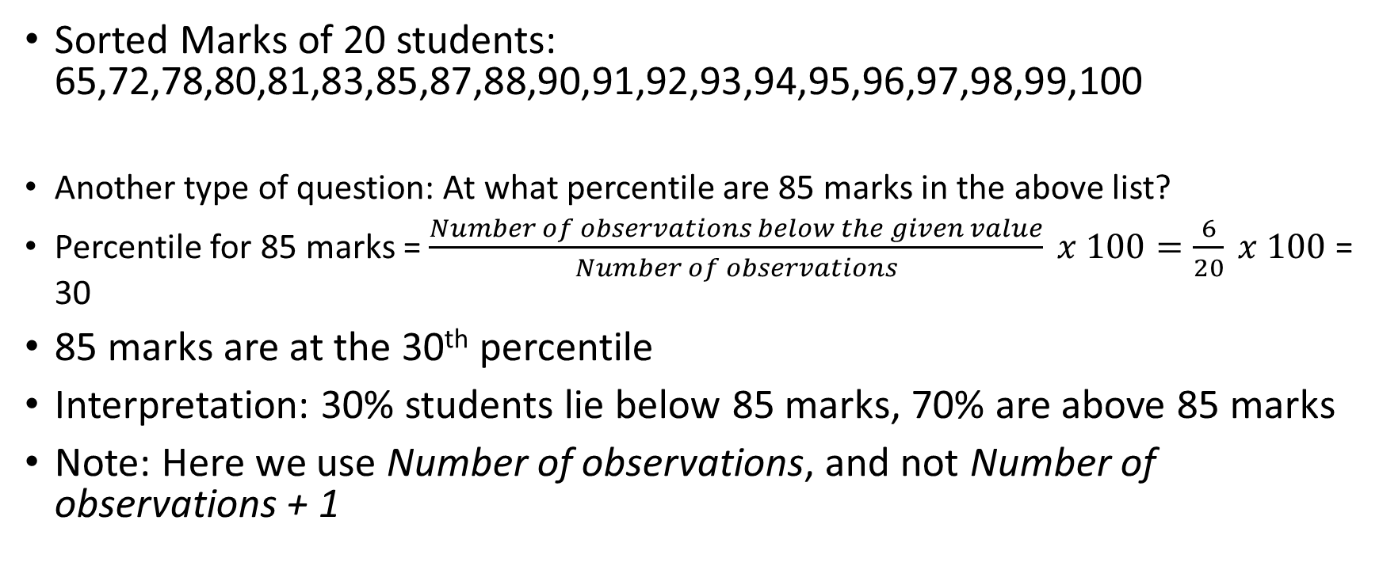
Percentile Example
Sorted Marks of 20 students: 65,72,78,80,81,83,85,87,88,90,91,92,93,94,95,96,97,98,99,100
Another type of question: At what percentile are 85 marks in the above list?
Percentile for 85 marks = $\frac{Number of observations below the given value}{Number of observations} x 100=\frac{6}{20} x 100$ = 30
85 marks are at the 30th percentile
Interpretation: 30% students lie below 85 marks, 70% are above 85 marks
Note: Here we use Number of observations, and not Number of observations + 1

Slide 20
US Household Net Worth and Percentile (Source: https://finance.yahoo.com/news/wealthy-net-worth-considered-poor-190014440.html)
Category | Percentile | Net Worth
Poor | 20th | $10,000
Middle class | 50th | $281,000
Wealthy | 90th | $1.9 million

Slide 21
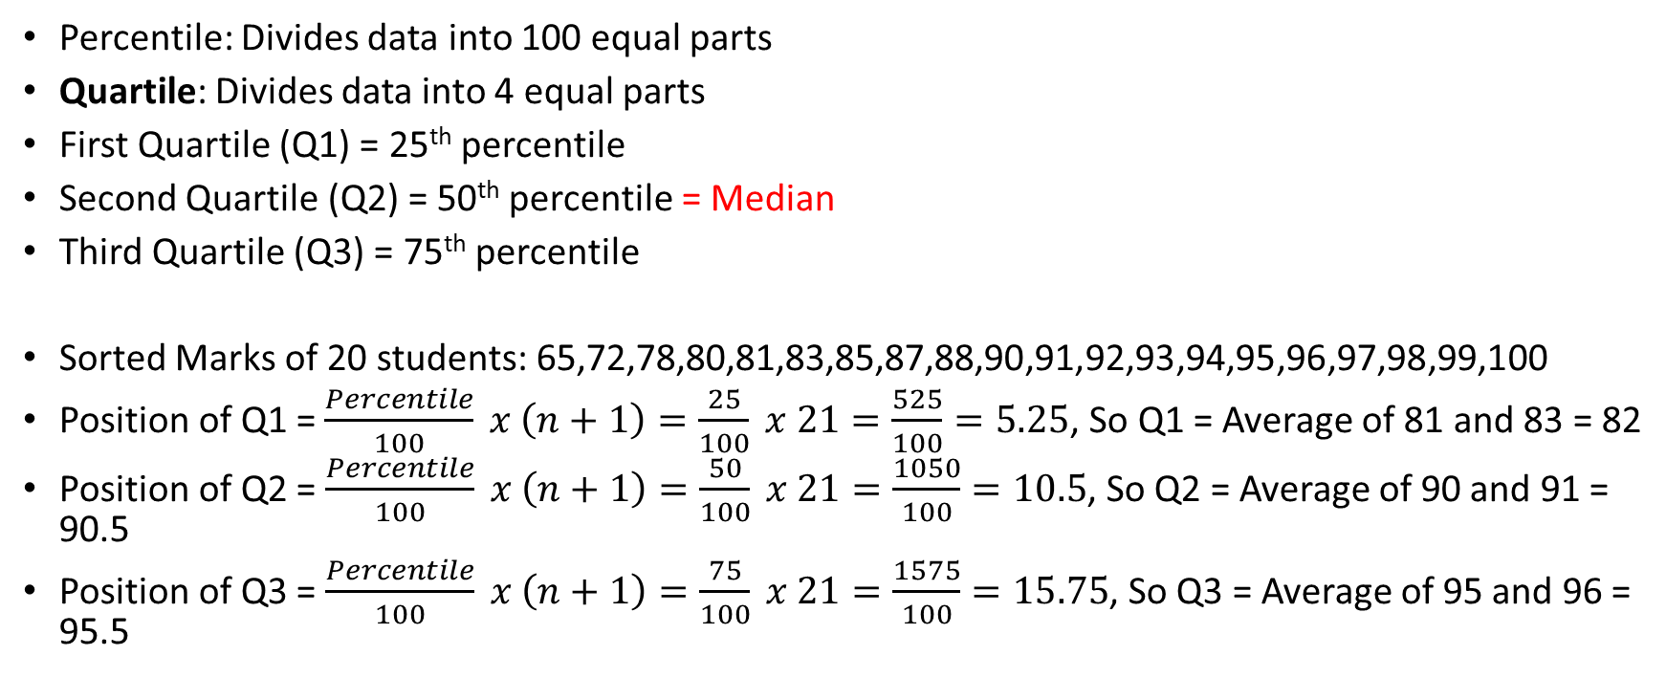
Quartile
Q1
Q2
Q3
Percentile: Divides data into 100 equal parts
Quartile: Divides data into 4 equal parts
First Quartile (Q1) = 25th percentile
Second Quartile (Q2) = 50th percentile = Median
Third Quartile (Q3) = 75th percentile
Sorted Marks of 20 students: 65,72,78,80,81,83,85,87,88,90,91,92,93,94,95,96,97,98,99,100
Position of Q1 = $\frac{Percentile}{100} x \left(n+1\right)=\frac{25}{100} x 21=\frac{525}{100}=5.25$, So Q1 = Average of 81 and 83 = 82
Position of Q2 =$\frac{Percentile}{100} x \left(n+1\right)=\frac{50}{100} x 21=\frac{1050}{100}=10.5$, So Q2 = Average of 90 and 91 = 90.5
Position of Q3 =$\frac{Percentile}{100} x \left(n+1\right)=\frac{75}{100} x 21=\frac{1575}{100}=15.75$, So Q3 = Average of 95 and 96 = 95.5
25%
50%
75%

Slide 22
Inter Quartile Range (IQR)
Inter Quartile Range (IQR) = Q3 – Q1 = Middle 50% of the data
In the given example: IQR = Q3 – Q1 = 95.5 – 82 = 13.5
Handles outliers better than range, since the extreme values at both the ends are ignored in IQR
Since it uses percentiles rather than actual values, it is less affected by skewed data (See Skewness)
Outliers: Data points that are significantly outside of the typical range of values
Lower bound: Q1 – (1.5 * IQR) = 82 – (1.5 * 13.5) = 61.75
Upper bound: Q3 + (1.5 * IQR) = 82 + (1.5 * 13.5) = 102.25
Points below the lower bound or above the upper bound are outliers
In our example, there are no such points, so we do not have any outliers

Slide 23
Outlier Example
Commute times for 14 randomly selected adults in minutes: 16, 8, 35, 17, 13, 15, 15, 5, 16, 25, 20, 20, 12, 10
Find outliers and draw a box plot
Solution: First sort them: 5, 8, 10, 12, 13, 15, 15, 16, 16, 17, 20, 20, 25, 35
Create a 5-number summary: Minimum, Q1, Q2, Q3, Maximum = 5, 12, 15.5, 20, and 35
Outlier
First calculate 1.5 * IQR = 1.5 x (20 – 12) = 1.5 x 8 = 12
Outliers calculation: Q1 – 12 = 12 – 12 = 0 and Q3 + 12 = 20 + 12 = 32
So, outliers = Commute time < 0 or > 32
Boxplot: Draw a vertical line between 5 and 35; Draw a box with 12 and 20; Draw a median line at 15.5, Show outlier points (See next slide)

Slide 24
Outlier Code
import matplotlib.pyplot as plt
import seaborn as sns
# Data
commuter_times = [16, 8, 35, 17, 13, 15, 15, 5, 16, 25, 20, 20, 12, 10]
# Create the box plot
plt.figure(figsize=(10, 6))
sns.boxplot(data=commuter_times, orient='h')
# Add titles and labels
plt.title('Box Plot of Commuter Times')
plt.xlabel('Minutes')
# Show the plot
plt.show()

Slide 25
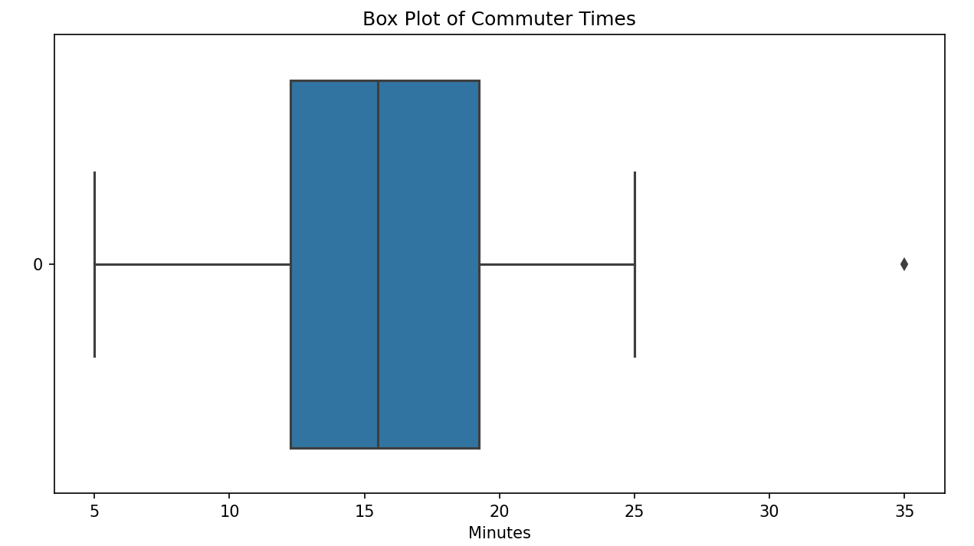
Resulting Boxplot

Slide 26
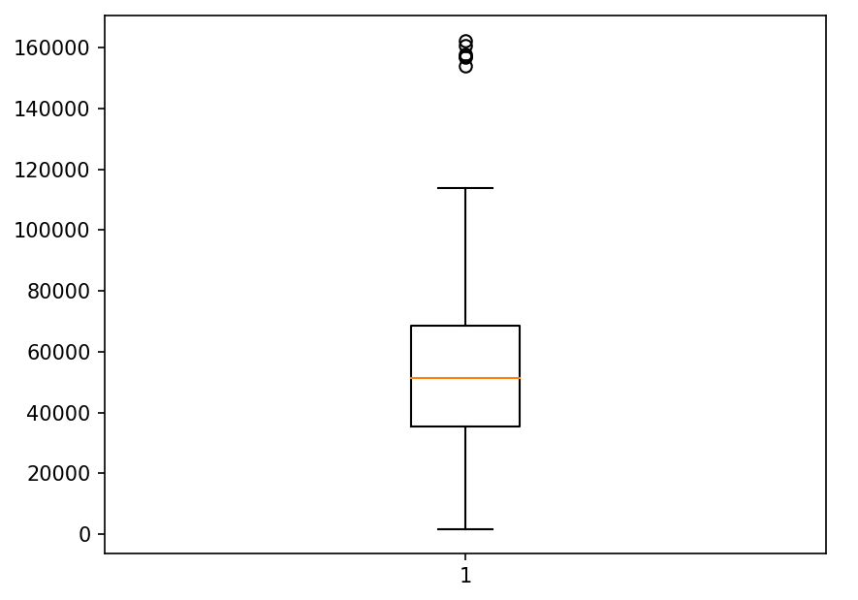
IQR and Box Plots for Outlier Detection
Maximum length of the whisker is 1.5 times that of IQR. Points beyond it are outliers.
Outlier: Any data point
below Q1 - 1.5 * IQR or
above Q3 + 1.5 * IQR
Outliers
Maximum (100%)
Whiskers
Q3 (75%)
Box represents middle 50% of the data points.
Short vertical box: Data is condensed around the median, Long box: Data points are not close to the median
Q2 (Median) (50%)
IQR
Q1 (25%)
Minimum

Slide 27
Outlier Detection Methods
IQR method: Data points below lower bound or above upper bound
Z-Score method: Data points with Z-score below -3 or above +3 (To be discussed later)
Code example:
C:\code\Data Analytics\outlier_analysis_iqr_z-score_simple.py
C:\code\Data Analytics\outlier_analysis_iqr_z-score.py (Different syntax)
Assignment: Do outlier analysis using IQR method for males and females separately for a dataset weight-height.csv
Enhancement: Use scatterplot to show outliers: outlier_analayis_iqr_height_weight.py

